Slide 1


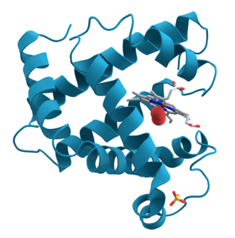

Climate
Drought
Resource acquisition traits
CAZyme genes
Enzyme Vmax
Litter chemistry
Physiology

